Slide 1
2024
Formlabs 3D Printer
By CMS Agency (Chloe, Manon, Stephen)
Notes:
By Chloe, Mannon, Steve

Slide 2
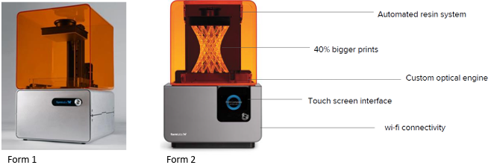
INTRODUCTION
Founders’ Vision
Humble Beginnings
Formlabs’ Success
Form 2 Launch

Slide 3
SWOT
STRENGTHS
OPPORTUNITIES
WEAKNESSES
THREATS
Technology Leader in 3D Printing
Partnerships
Direct Sales Model
Increased Specialization
Affordability
Limited Product Line
Increased Competition
Limited Reach
Technological Advancements

Slide 4
5-C Framework
01
02
03
04
05
Customers
Company
Collaborators
Competitors
Context
Target professional consumers (Engineers, Education Institutes, Dentists)
B2B - B2C
Significant growth
-
Improving current products (3D Printer, Resin, Softwares)
Channel partners in Europe & Asia (Express Group, iGo3D)
-
Considering CAD resellers
Other 3D printer manufacturers (Ultimaker, 3D Systems, MakerBot)
- Keep up with innovations
- Keep up with audience trends
- Understand safety regulations

Slide 5
Porter’s Five Forces
THREAT OF NEW ENTRANTS
BARGAINING POWER OF SUPPLIERS
Moderate to High:
Top 50 global distributors by sales represents 75% of industry revenue
Low to moderate:
Requirement for significant technological expertise, intellectual property, and capital investment
BARGAINING POWER OF BUYERS
THREAT OF SUBSTITUTES
Moderate:
-Lots of customers in the market
-Authorizations needed for some of them
Low:
CNC machining and injection molding
High:
In 2014, about 140,000 desktop 3D printers sold.
Lots of competitors
RIVALRY AMONG EXISTING COMPETITORS

Slide 6
BCG Matrix
HIGH
LOW
Stars
Question Marks
- Form 2 3D Printer: Cutting-edge technology
- Software innovations and consistent updating
- Hold significant market share
- Introducing biocompatible resin
- Possible other new products
- Would require more investment and R&D
HIGH
- Existing 3D printers, resin, & software offerings dominate market
- Formlabs growth is consistent and stable
- Could consider Form 1 3D printer
- Lessly used resins
LOW
Cash Cow
Dog

Slide 7
Market-Product Matrix
Current customers
New customers
Engineers and product designers
Form 1, 1+, 2
Europe and Asia
Form 1, 1+, 2
Current products
Engineers and product designers
Form 3+
Dental industry
Biocompatible resins
New products

Slide 8
Product Life Cycle
2011-2013
Fall 2014
Problems Arise, Form 1+
10,000 Printers Shipped
Prototype Form 1
Premiere of Form 2
Spring 2014
Fall 2015

Slide 9
Product Life Cycle
Introduction
Maturity
Form 2
Form 1, Form 1+
Growth
Decline

Slide 10
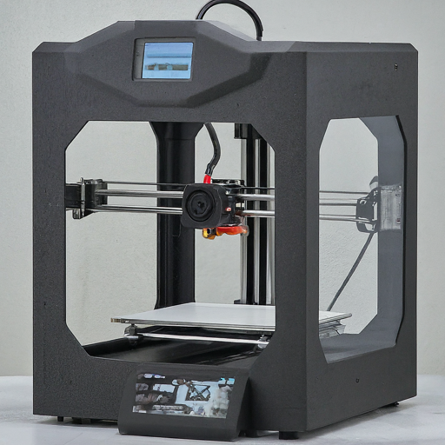
Disruptive Innovation
3D Printing Revolution
Booming Industry
Notes:
(You can remove the image if you would like too)

Slide 11
Identified Issues
Competitors
Partnerships & Distribution
Receiving Feedback
- Aligning with goals
- Be able to reach audience
- Cost-efficient distribution
- Avoiding channel conflict
- Requires training resources
- Products may technologically surpass theirs (“outdated”)
- Requires consistent innovation and updates
- Losing market share
- Keeping differentiation
- Rely on feedback
- Partnerships may lessen ability to gain such
- Need to continue fostering customer-centric approach

Slide 12
Our Recommendations
Market development:
Diversification :
Europe and Asia
Form 1, 1+, 2
-> Partnership with Print-It-Shop
Training on the product
Dental industry
Biocompatible resin
-> Partnership with Dental Goods

Slide 13
THANKS!
Do you have any questions?
Chloe, Manon and Stephen

